Slide 1
Automation Solutions
IMPROVISING GENERATIONS

Slide 2
Home Automation
With the Internet of Things taking over the lives, automation has made lives simpler and homes smarter. Smart homes are the base to smart cities and a much secure lifestyle. It is a connected home technology that is designed to automate functions and grant you control over the property. Home control mechanism gives you the access to control the security of the house. It works on mobile application control which can be integrated with the security systems installed. You can set the schedule, and the rest is automated and based on your personal preferences thus providing convenience, control, money savings, and an overall smarter home. Home automation can also alert you to events that you might want to know about right-away while you are gone like water leaks and unexpected access to your home etc.

Slide 3
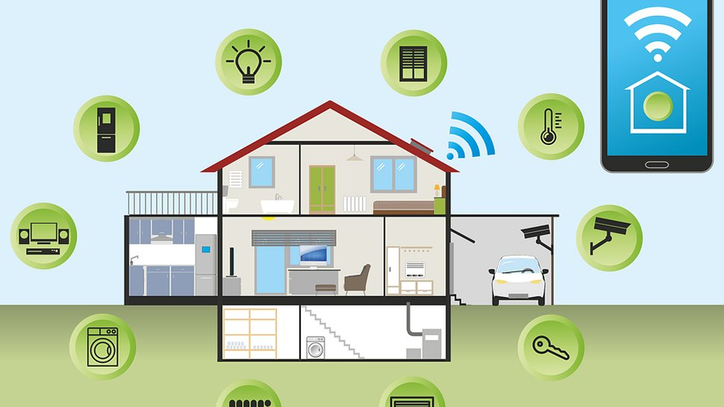
Home Automation Functionalities

Slide 4
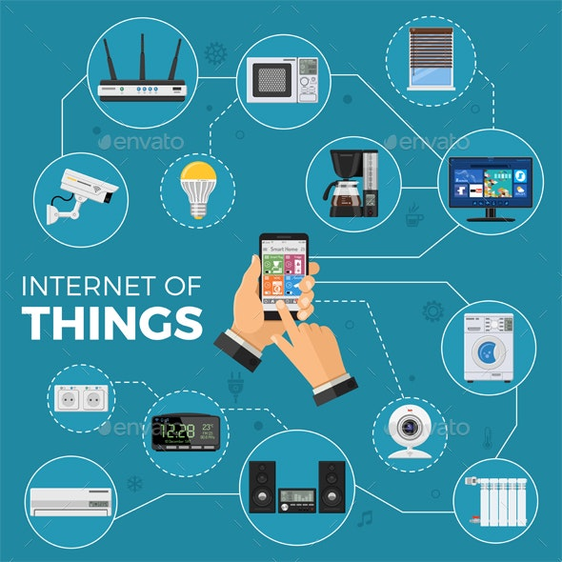
Internet Of Things
Role of IoT in Home Automation. The IoT based Home Automation will enable the user to use a Home Automation System based on Internet of Things (IoT). The modern homes are automated through the internet and the home appliances are controlled. The user commands over the internet will be obtained by the Wi-Fi modems

Slide 5
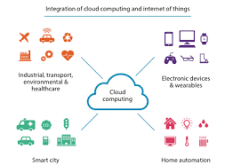
Cloud Computing
Cloud computing has the potential to provide easy access to home automation for the general public by providing easy to use online services. Open and standardised protocols for home automation devices further increase the convenience by offering more choice and freedom to the customer.

Slide 6
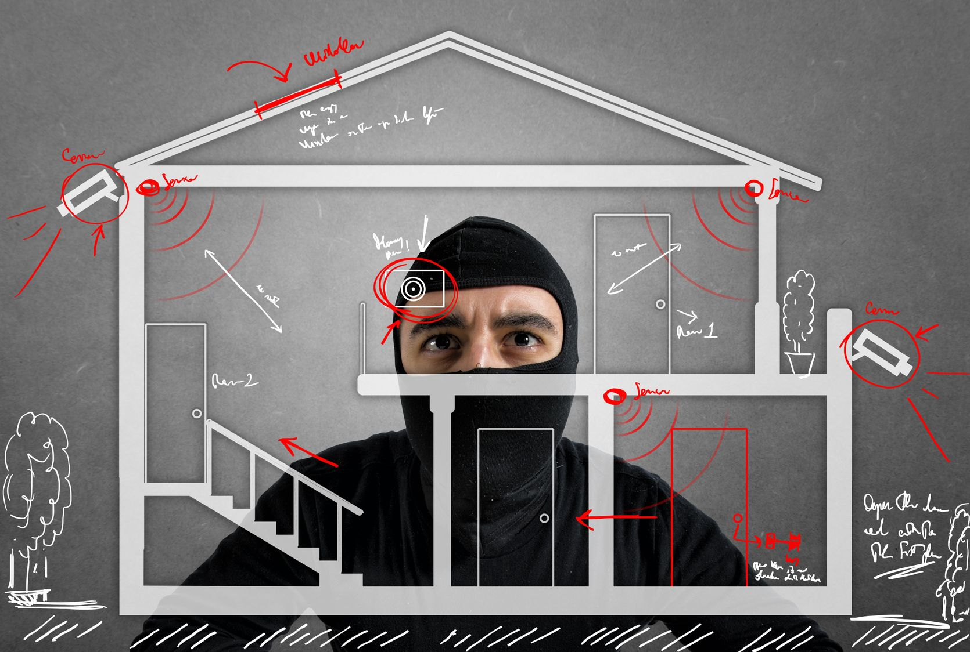
Security
Home automation hacking is when cyber criminals exploit insecure IoT devices to gain access to the entire system. ... When device settings are not updated, hackers can easily use these default credentials to hack into the connected device, allowing them to gain access to your entire network.

Slide 7
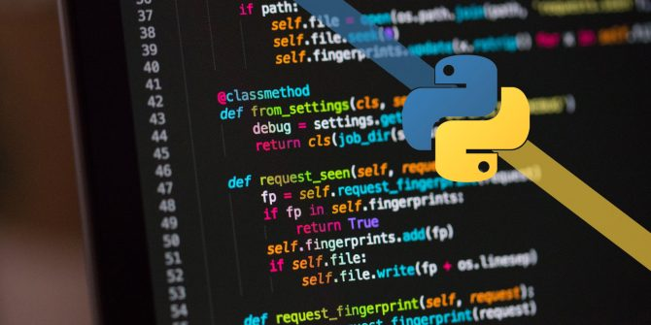
Programming Concepts
Python Language Usage

Slide 8
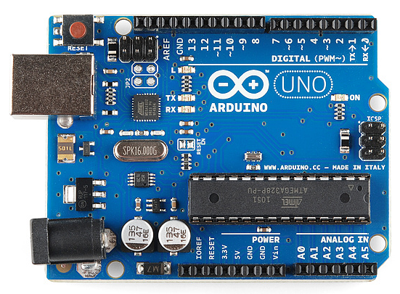
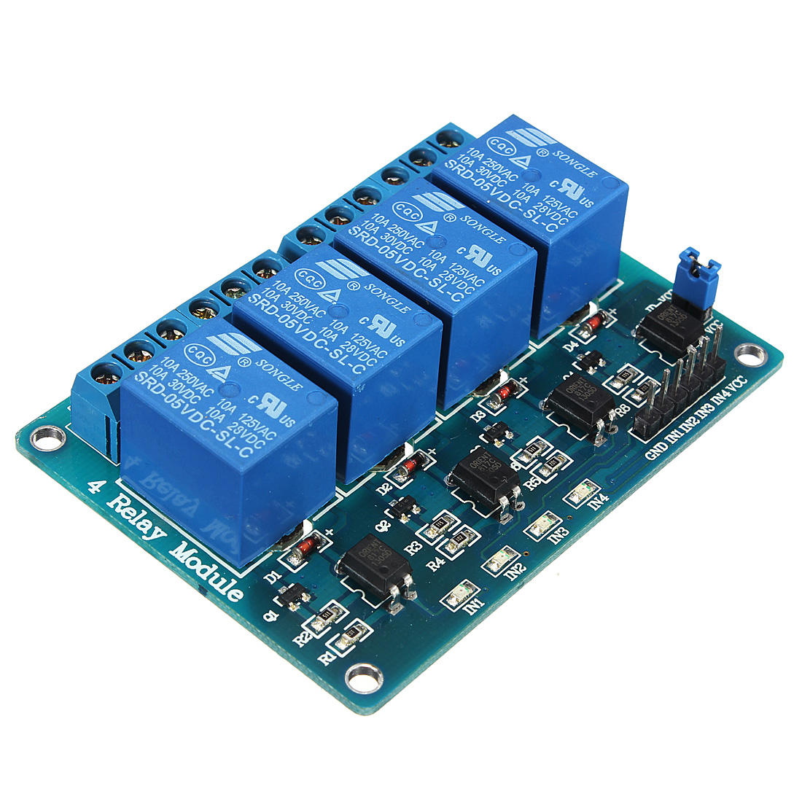
Hardware
ARDUINO
RELAYS

Slide 9
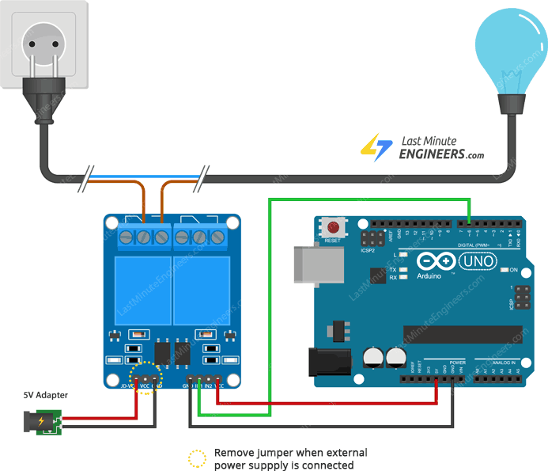
Basic circuit Diagrams

Slide 10
Automation is the future
The Future of Automation. With rapid development in artificial intelligence (AI) and robotics technology, automation is at a tipping point. Today, robots can perform a slew of functions without considerable human intervention. ... Automation will bolster connectivity and reliability in a hyper-competitive ecosystem
CONTINUED..

